Slide 1


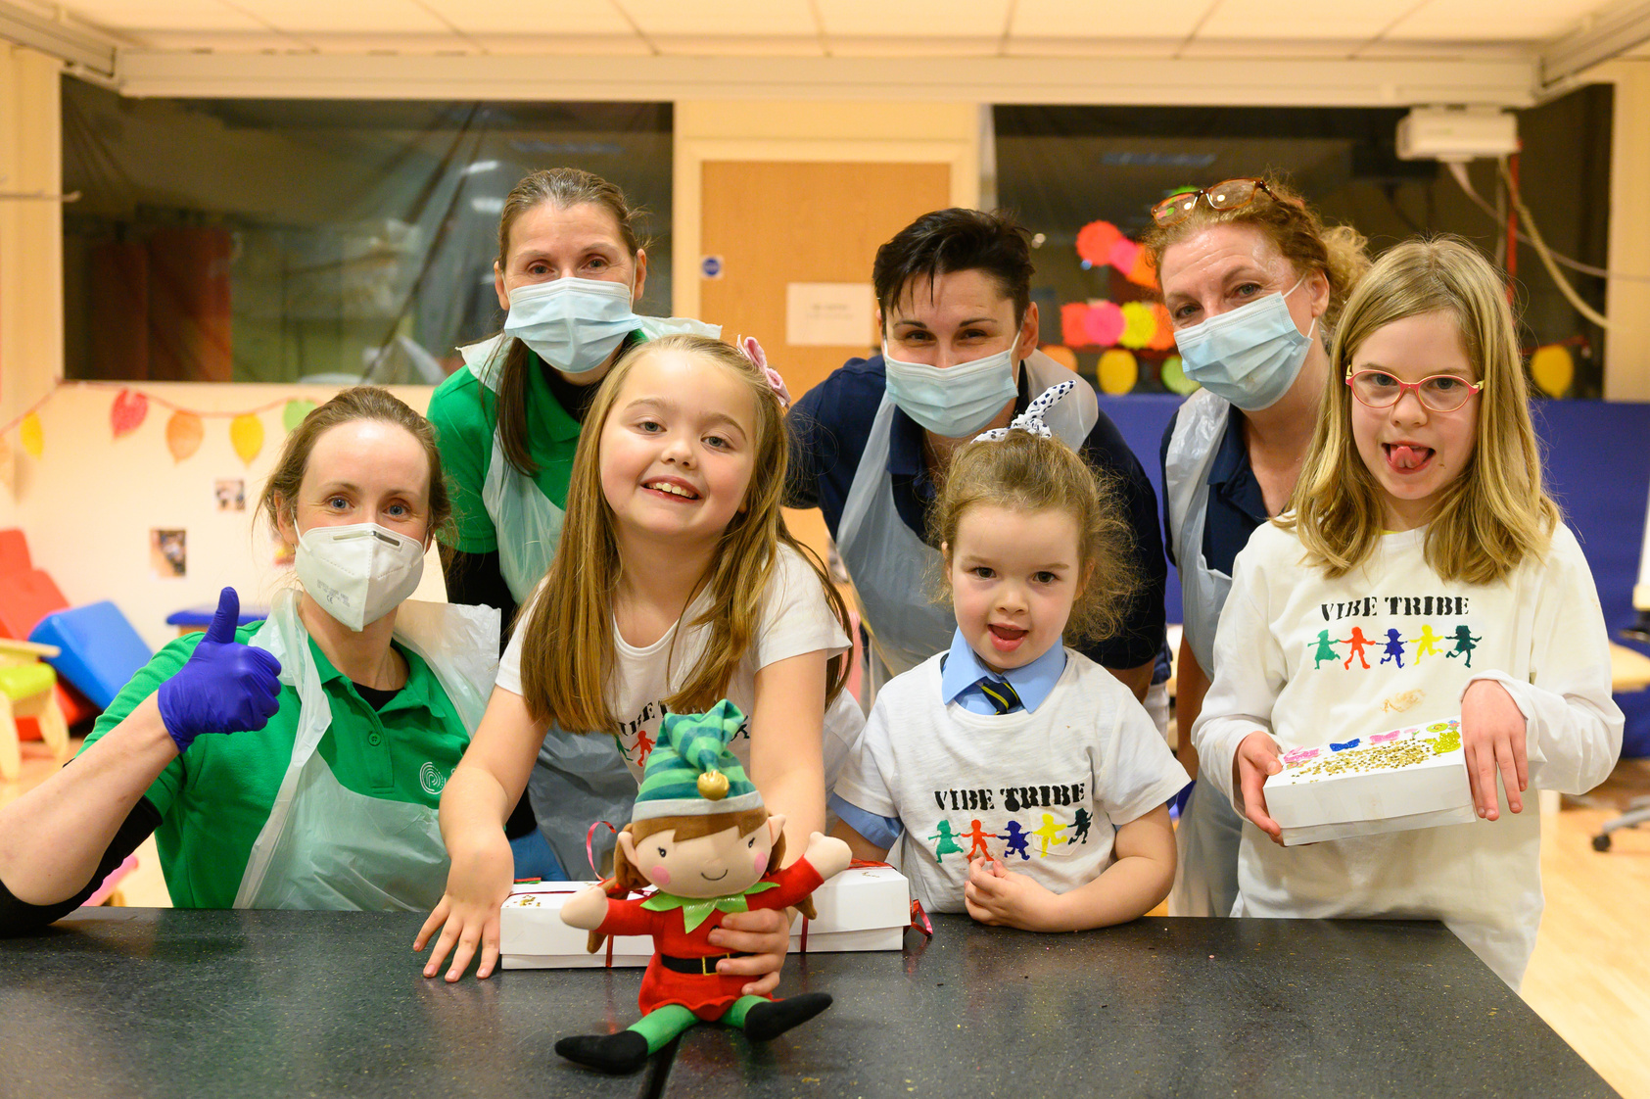
Objectives
  What is a disability?
  What is cerebral palsy?
  What do people with cerebral palsy want you to know?
  Why we are celebrating World Cerebral Palsy Day.

Slide 2

Do you know what a disability is?

Slide 3
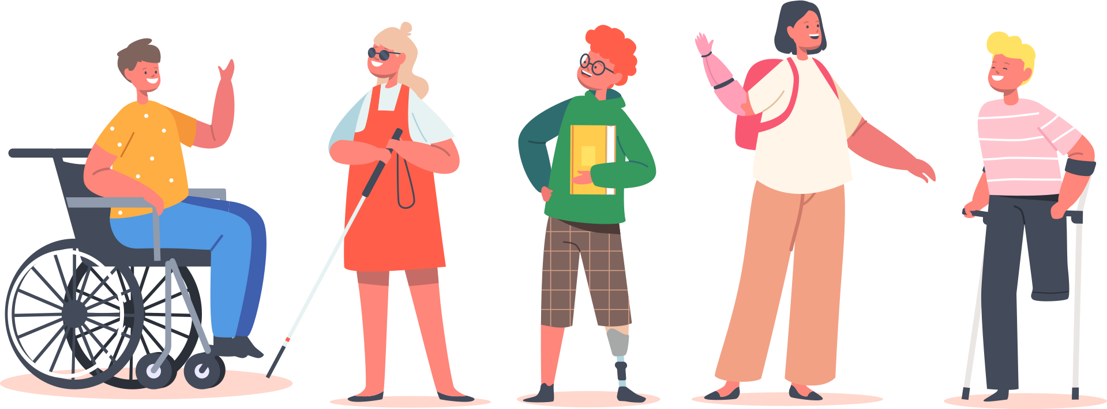
What is a disability?
A disability is when a person has extra challenges doing certain activities or interacting with the world around them.
Source: National Center on Birth Defects and Developmental Disabilities, Centers for Disease Control and Prevention

Slide 4
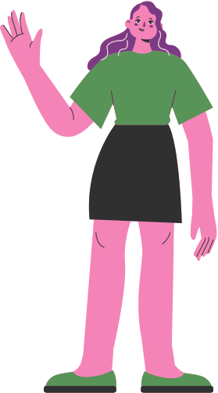
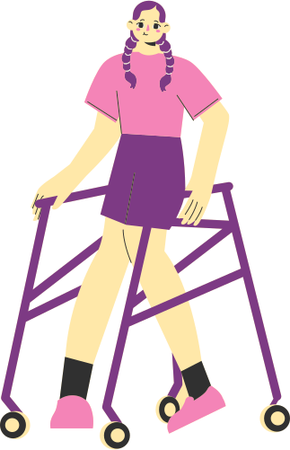
What is a disability?
A disability can affect your body or your brain.
Living with a disability is different for every person.

Slide 5
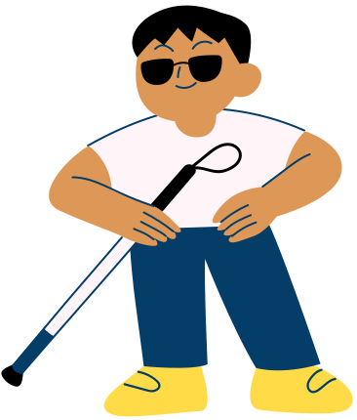
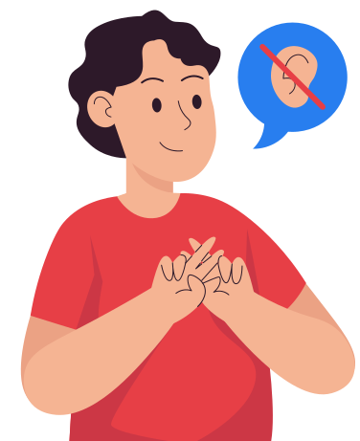
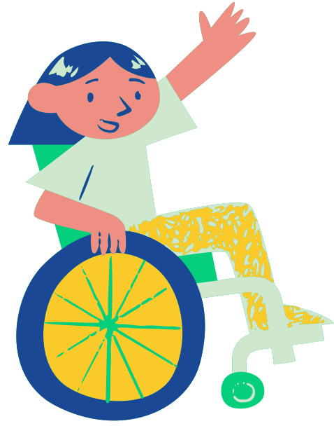

Some people may have their eye sight affected.
Some people may have their hearing affected.
Some people may use a wheelchair.
Some people may have a disability you can’t see, such as a learning disability.

Slide 6
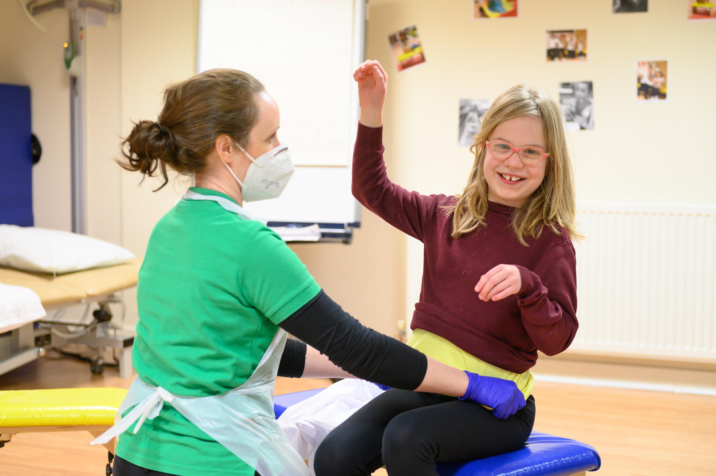
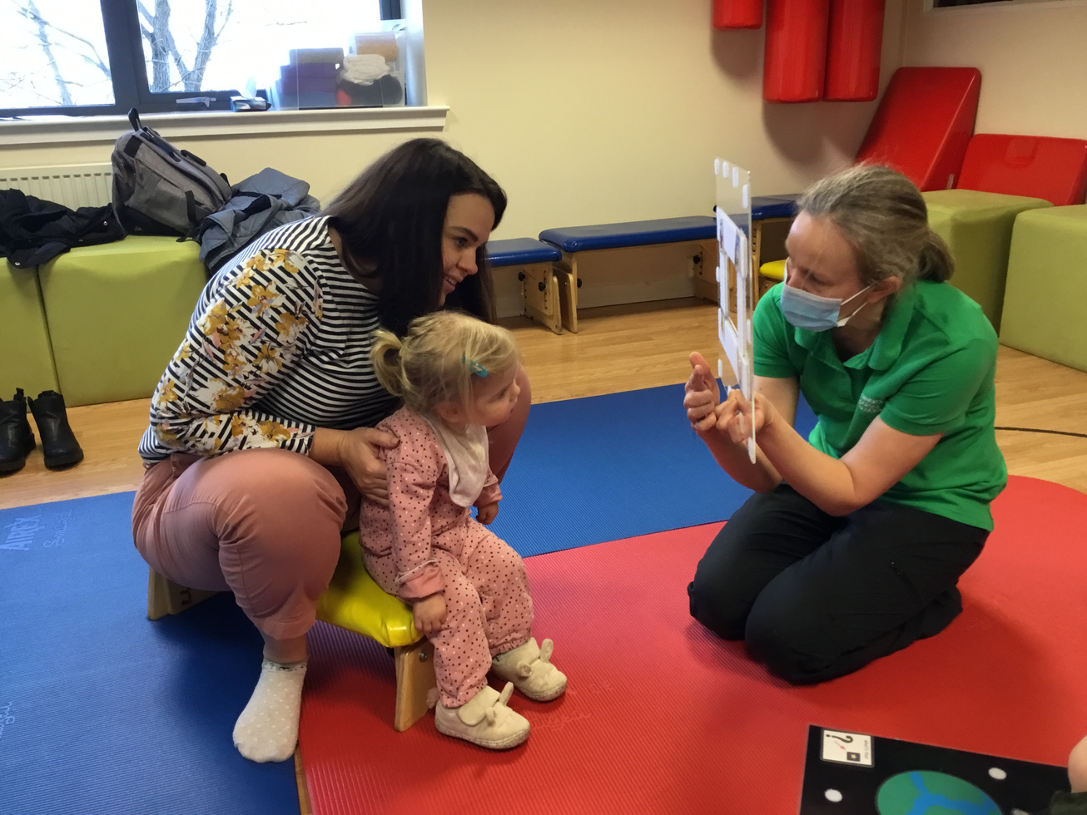
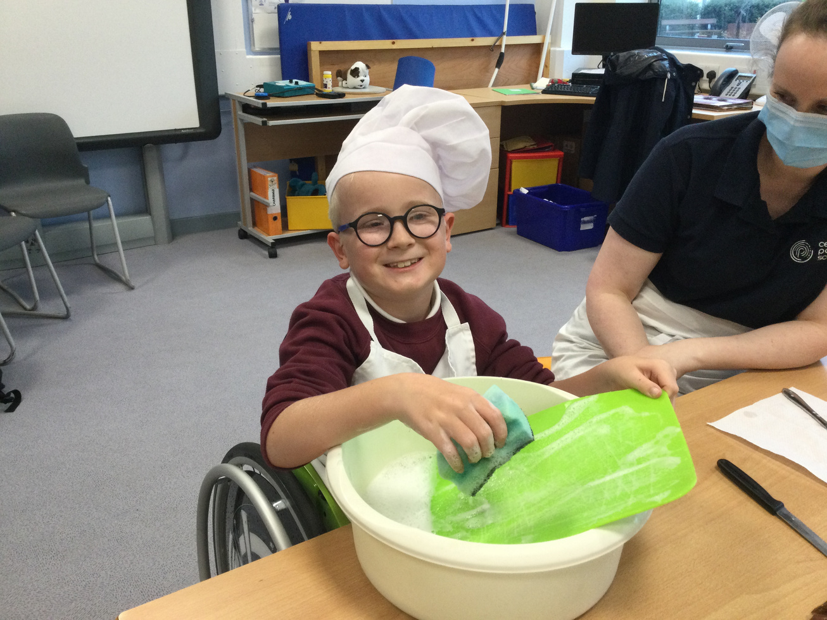
What is cerebral palsy?
Cerebral palsy (CP) is a disability that affects a person's body.
A person develops cerebral palsy before they are born or as a new-born baby.

Slide 7

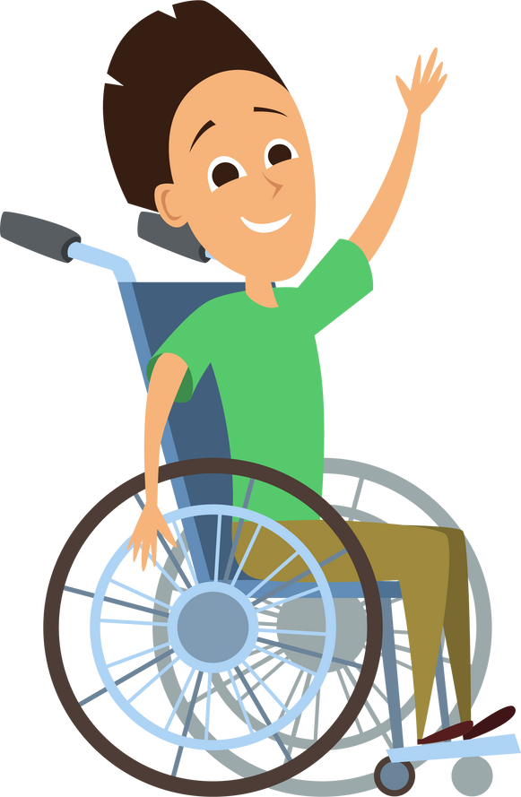

There are 17 million people with cerebral palsy worldwide.
17 million people
It is the most common physical disability in children.
In Scotland, around 150 babies are born each year with cerebral palsy.
Source: World Cerebral Palsy Day https://worldcpday.org/portfolio-item/what-is-cp-infographic/

Slide 8
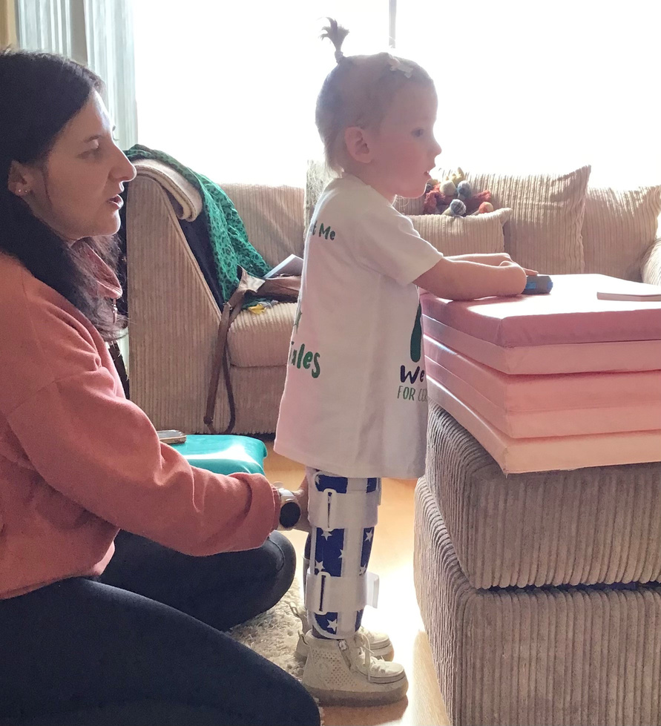
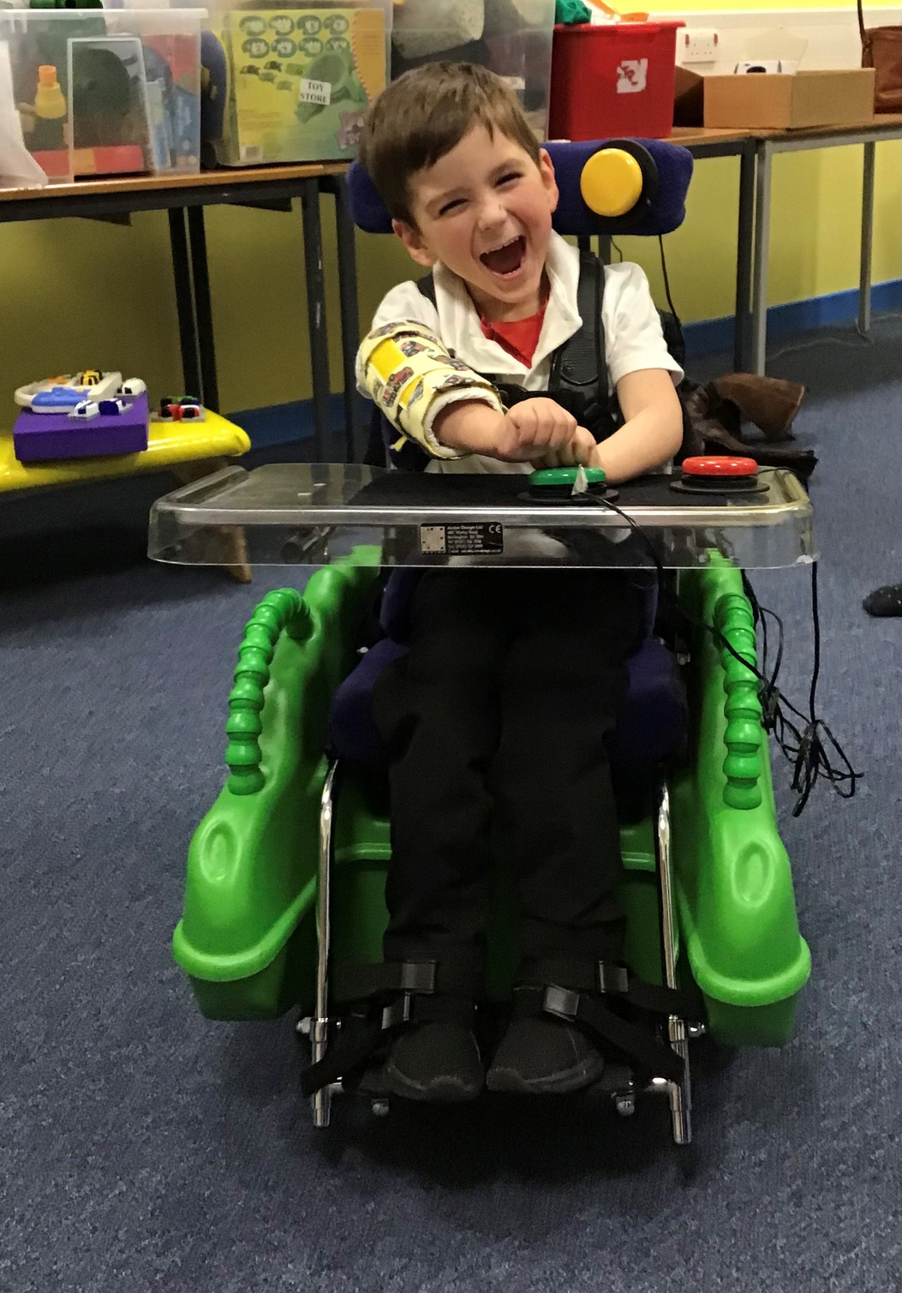
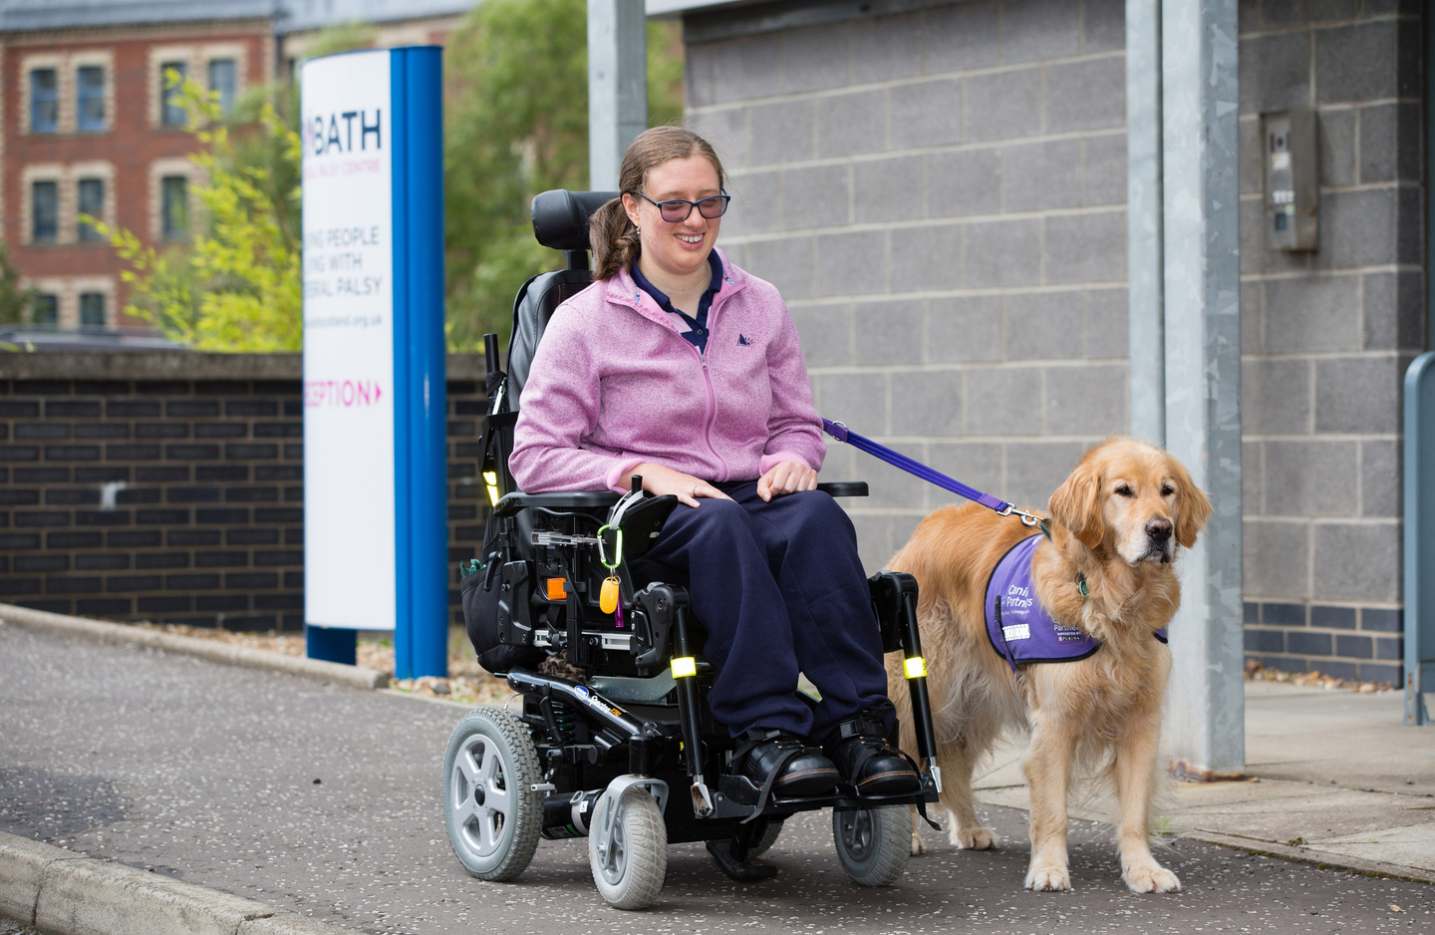
Cerebral palsy can affect a person's ability to:
  balance
  control their movements
  hold themselves up without help

Slide 9
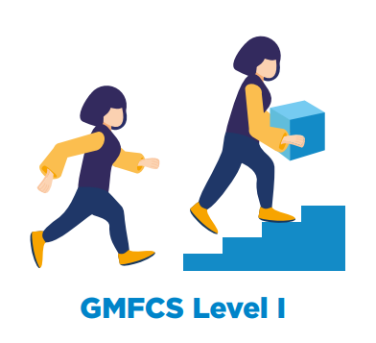
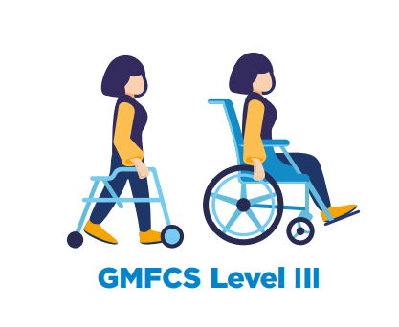
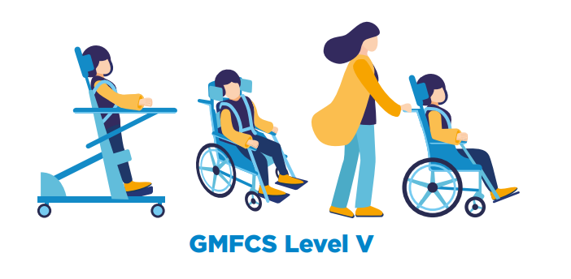
Every person experiences cerebral palsy differently.
Some people can walk and run.
Some people use a walking frame or wheelchair, and can move without help.
Some people use a wheelchair all the time and need help to move.
Image: World Cerebral Palsy Day https://worldcpday.org/portfolio-item/what-is-cp-infographic/

Slide 10
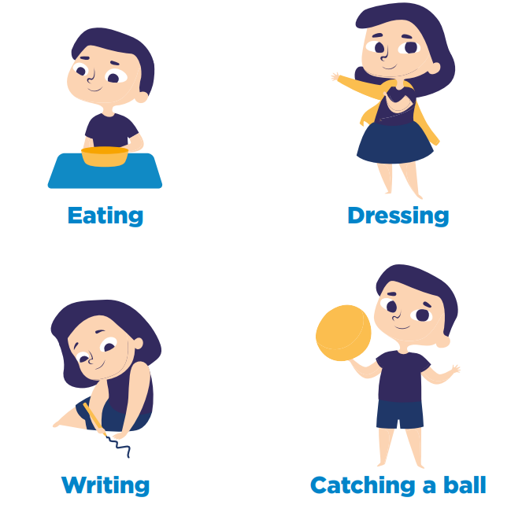
People with cerebral palsy may need help with everyday tasks.
Image: World Cerebral Palsy Day https://worldcpday.org/portfolio-item/what-is-cp-infographic/

Slide 11






Cerebral palsy affects movement, but some people with CP can live with additional challenges too.
Unable to talk, and use other ways to communicate
Unable to walk
Experience pain
Eye sight affected
Find it hard to sleep
Learning disability

Slide 12


Meet Amber
"Amber's cerebral palsy affects all four limbs, and she struggles to hold anything in her hands or do anything functional without adult assistance.
She’s non-mobile and pretty much non-verbal.
She does understand everything you say to her and, if she’s asked a direct question, she will answer ‘yes’ or ‘no’.
Amber has just started primary school which she attends with her sister.... She’s really enjoying it and is very happy to go to school."
- Cheryl, Amber's mum.

Slide 13
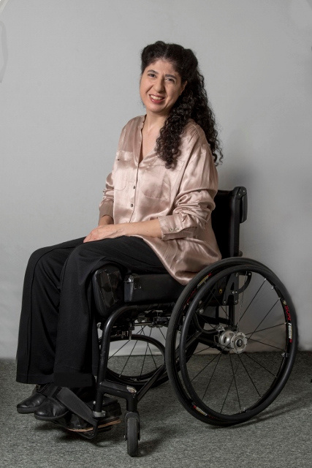
Meet Nada
"I’ve had cerebral palsy since birth, which affects the lower half of my body and I use a wheelchair most of the time and elbow crutches occasionally.
I left school at 16 and went to college, had various jobs, and eventually got an Honours degree at the University of Edinburgh as a mature student. When I was at university, I began to explore my passion for dance. Ever since then I have gone to classes and performed."
- Nada

Slide 14
Do you know anyone with cerebral palsy?

Slide 15




What is the main thing you wish others understood about cerebral palsy?
I have cerebral palsy; I'm NOT stupid - I can do things. Look at the ability as well as the disability.
CP is a massive scale and affects everyone differently.
You might have cerebral palsy but you still have intelligence and a good sense of humour. Therefore, talk to the person!
Treat those with cerebral palsy the same as you would any other person.
Look beyond the disability and treat the person as an individual. You'll meet a cracking person with a great sense of humour and amazing determination.
It's only a diagnosis and doesn't define you. I wish people would see beyond the physical challenges and see the very bright, clever child who has a lot to say.

Slide 16
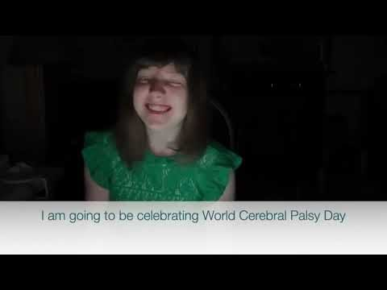
Why are we celebrating World Cerebral Palsy Day?
Notes:
To play the film must be playing the PowerPoint.

Slide 17

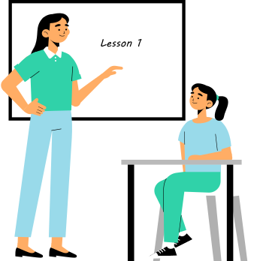
Thank you for celebrating World Cerebral Palsy Day 2023.
Write down one thing you have learnt today.

